Slide 1

Crop prediction
Prepared by
KARTHIKEYAN S

Slide 2
Table of content
Agenda
Understanding the Variable
Process followed in the Project
Architectural Explanation
Model 1 and Model 2 description and Results

Slide 3
Agenda
Nowadays farmers need not know which plant should be planted according to their soil fertility. The soil consists of Nitrogen(N), Phosphorus(P), and Potassium(K) content for plants to grow in the soil.
According to soil fertility, p[H] level, and average rainfall we can able to give a solution using Artificial Intelligence Technology under the Machine Learning concept

Slide 4
Understanding the Variable
Nitrogen(N)
Phosphorus(P)
Potassium(K)
Rainfall
P[H] level
Temperature
Humidity
Label
In this project Nitrogen(N), Phosphorus(P), Potassium(K), Rainfall, Temperature, Humidity, and p[H] level are independent variables and the Label is dependent on variable

Slide 5
Process followed in Project
Data Collection
Cleaning Data
Building Model
Training Model
Testing Model
Make Prediction

Slide 6
Data Collection
Data collection is the procedure of collecting, measuring, and analyzing accurate insights for research using standard validated techniques.
In most cases, data collection is the primary and most important step in the research
The approach of data collection is different for different fields of study, depending on the required information.
The data collection is made through phone calls, Mails, etc.
Cleaning Data
Cleaning the data is the process of removing or fixing the incorrect, corrupted, duplicate, or incomplete data with the dataset
When combining multiple data sources, there are many opportunities for data to be duplicated or mislabelled.
If the data with missing values and incorrect values, the model will not train properly, and the predicted output can incorrect.

Slide 7
Building the Model
In this process the dataset that was loaded was split into training and testing datasets. Then the suitable algorithm is selected and it was for into a model.
While splitting the training needed more or equal space compared to testing. For Example, it can be in the format of 70% - 30% or 60% - 40% or 50%-50% or 80% - 20%
Training model
A training model is a dataset that is used to train an ML algorithm. It consists of the sample output data and the corresponding sets of input data that influence the output.
Testing model
Model testing is referred to as the process where the performance of a fully trained model is evaluated on a testing set.

Slide 8
Architectural Explanation

Slide 9
Model 1
The train for the model is done in a random state of the computer and fitting the data values to the Naive Bayes algorithm as it contains 2000 data
For multiclass I have used a one vs rest classifier for training the model and calculated accuracy for the model
The accuracy score I obtained was 99.54
The f1 score was 1.00

Slide 10
Model 2
The train for the model is done in a random state of the computer and fitting the data values to the Random Forest algorithm as it contains 2000 data
For multiclass I have used a Random Forest classifier for training the model and calculated accuracy for the model
The accuracy score I obtained was 99.24
The f1 score was 0.99

Slide 11
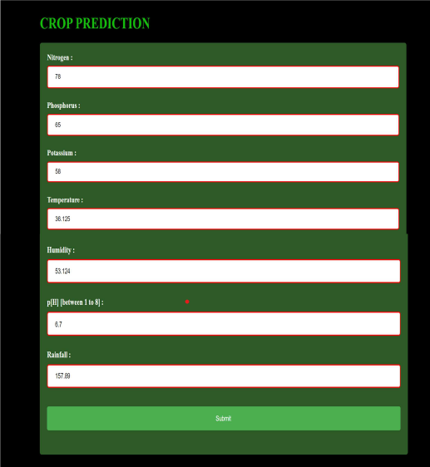
Result

Slide 12
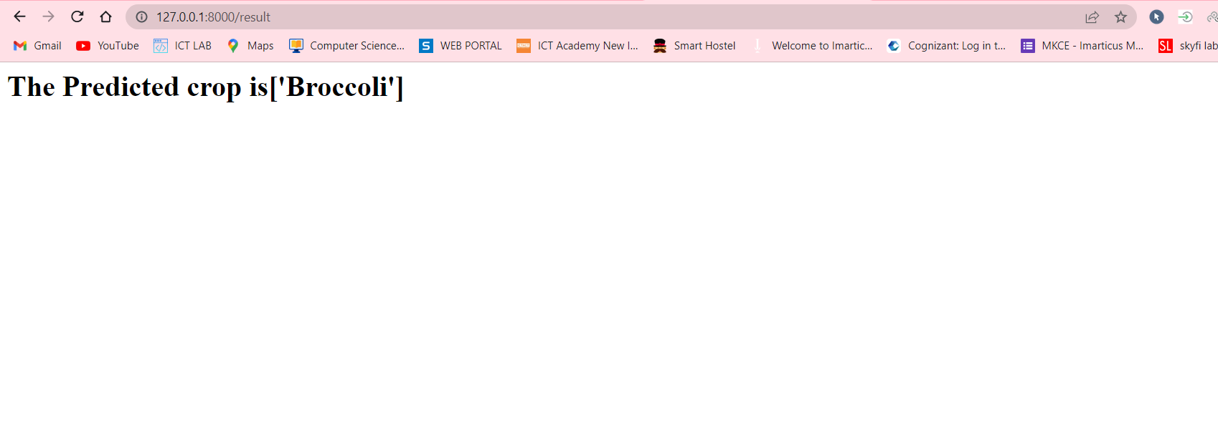

Slide 13


Slide 14


